Slide 1
TEAM AGGREGATORS
Recommendation System

Slide 2









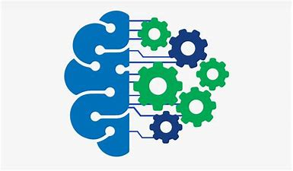
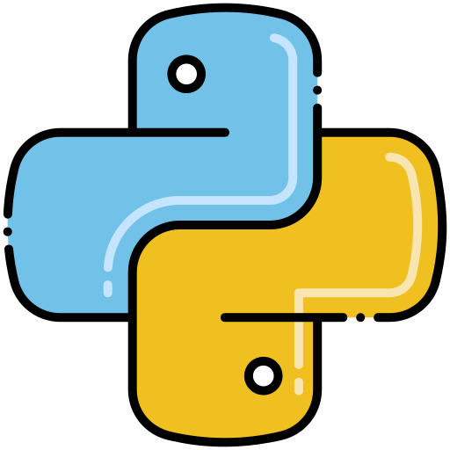
Tech Stack:
Backend :
Django/NodeJs
ExpressJs
Frontend:
ReactJS
Html
Machine Learning:
Python
Python Libraries (Numpy, Pandas, Surprise, Sklearn, Seaborn)
MongoDB
CSS
JavaScript

Slide 3
Our Approach:
We have used state of the art training models like SVD (Singular Value Decomposition) to provide more accurate recommendations to the users.
Blending filtering techniques like collaborative filtering and demographic filtering for generating feature dependencies.
We have used the most popular JavaScript library- ReactJS which is more efficient at rendering dynamic content which in turn provides smoother user experience.
We have used the MERN stack which is a cost effective stack since it is open source, has an accessible setup and is easy to learn and implement.

Slide 4
Recommendation System
What is a Recommendation System?
Recommendation systems are type of intelligent information entering systems that predicts rating and preferences of user on products. The primary application of recommendation system is finding a relationship between user and product to maximise user-product engagement. The major application of our recommendation system is to generate product based on transactions made by similar users and engagement of the users with related products.
Need for Recommendation System:
The main key reason why we need recommendation system in modern society is that we have too many options to select from due to prevalence of internet. Due to this people have hard time to select/find products which actually interests them. This is where recommendation systems comes into the picture.

Slide 5
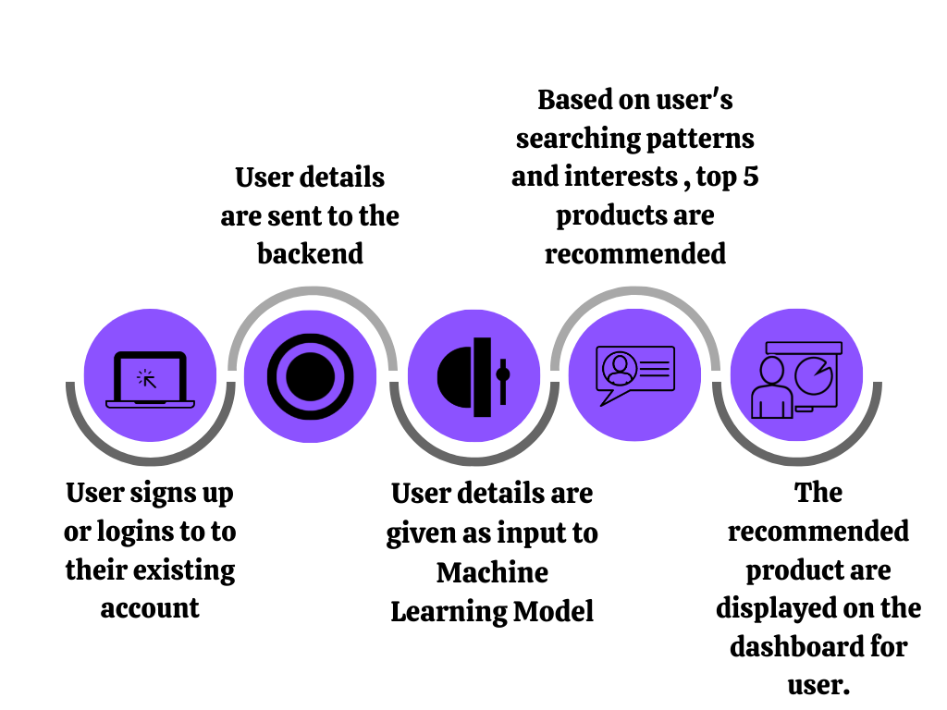
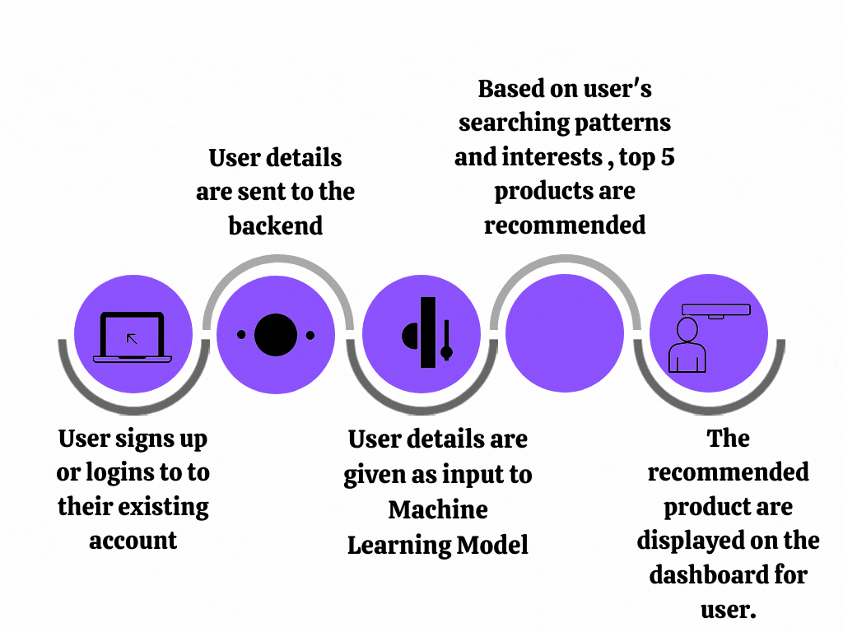
Process Flow

Slide 6
Project Architecture
C1 : Old user-- The user logs in by email and password which sends a post request to the backend. The backend authenticates the user by fetching the user data from mongoDB. If authentication is successful a post request is made to Django server and recommended products are shown on front end , if not the user is redirected to sign up page.
C2 : New User-- In case of a new user their information is updated in the database and top rated products are displayed on their dashboard.

Slide 7
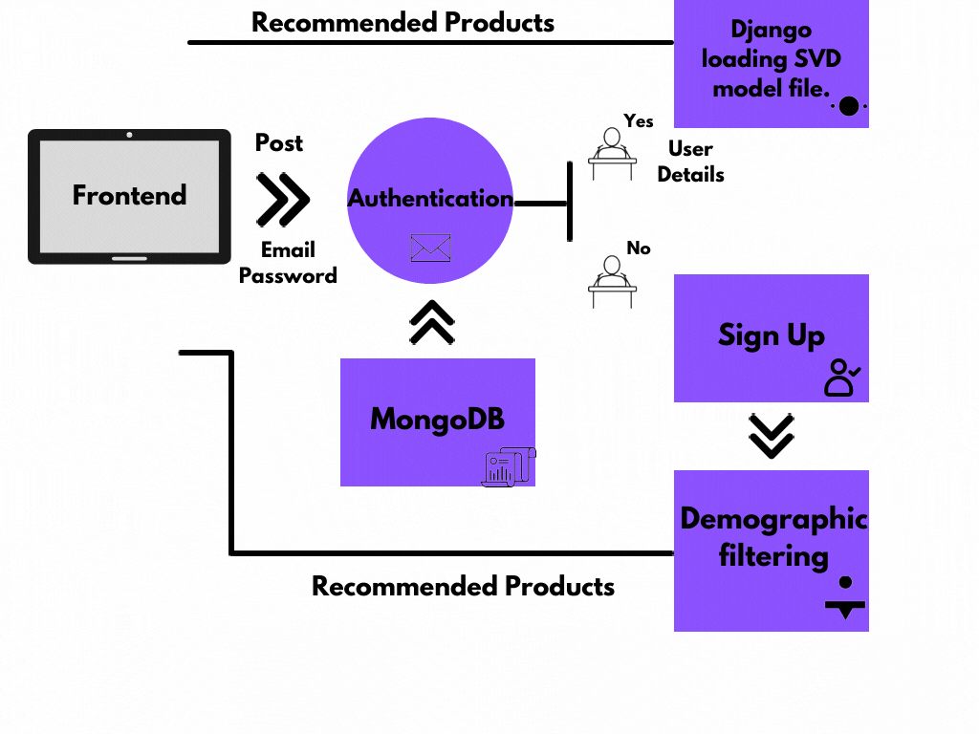
Project Architecture

Slide 8
Data Set
We scraped the Bajaj Finserv website to get a list of products on the website.
We obtained a dataset of an e-commerce website from kaggle and mapped the products found by web scraping on to the existing products to create a new hypothetical dataset for bajajfinserv
We used this dataset to train the model mentioned below.

Slide 9
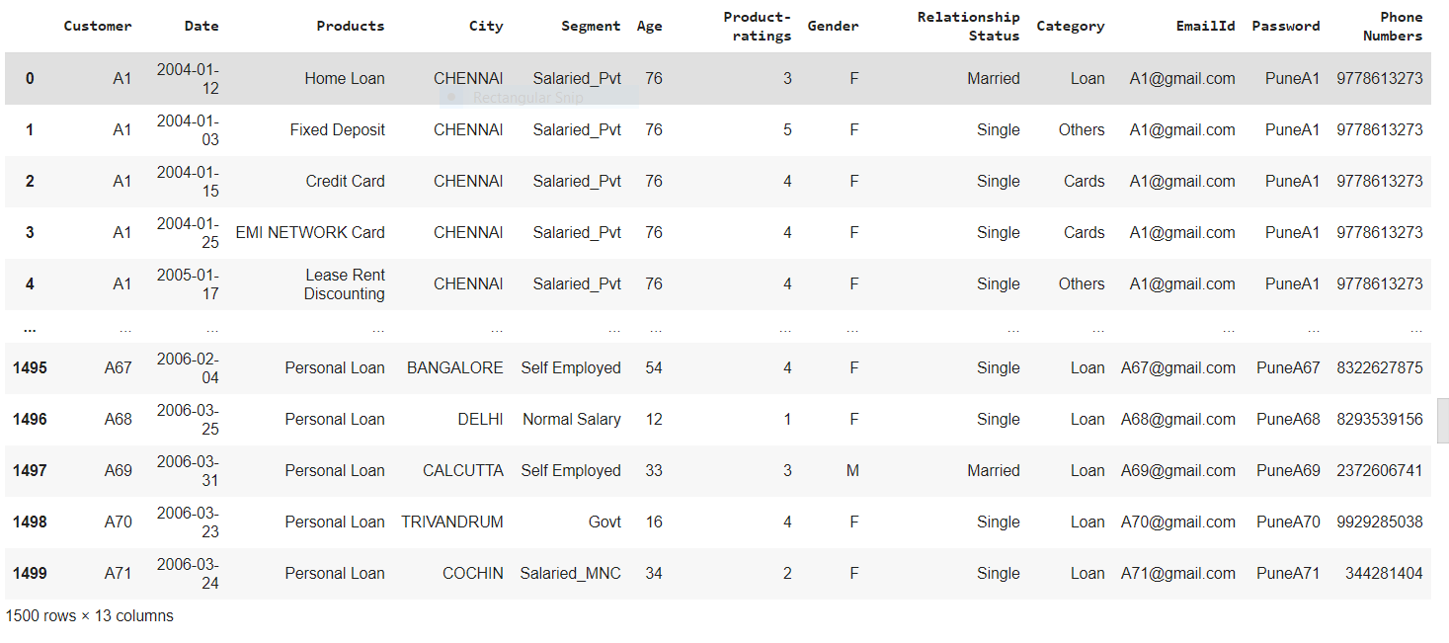
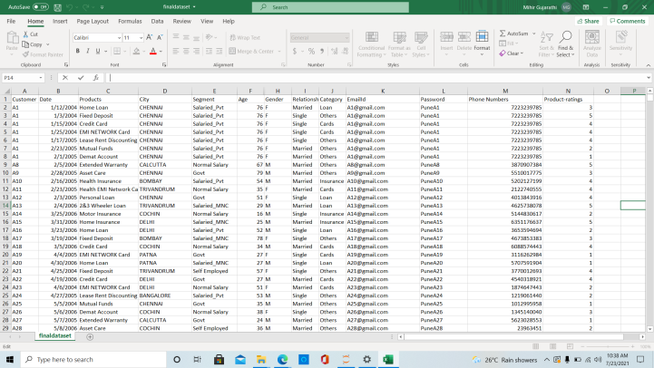

Slide 10
Singular Value Decomposition:
SVD uses a matrix structure where each row represents a user, and each column represents an item. The elements of this matrix are the ratings that are given to items by users.
It constructs a matrix with the row of users and columns of items and the elements are given by the users’ ratings.
SVD can be calculated by calling SVD() function.
Regularization is used to avoid overfitting and generalize the dataset by adding the penalty.

Slide 11
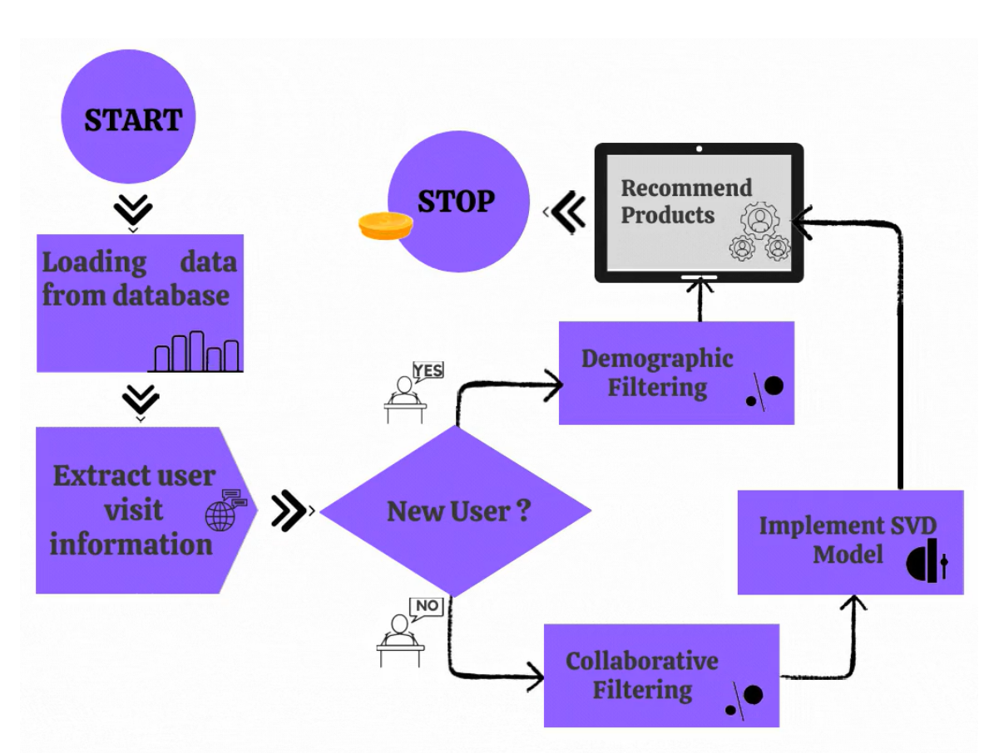
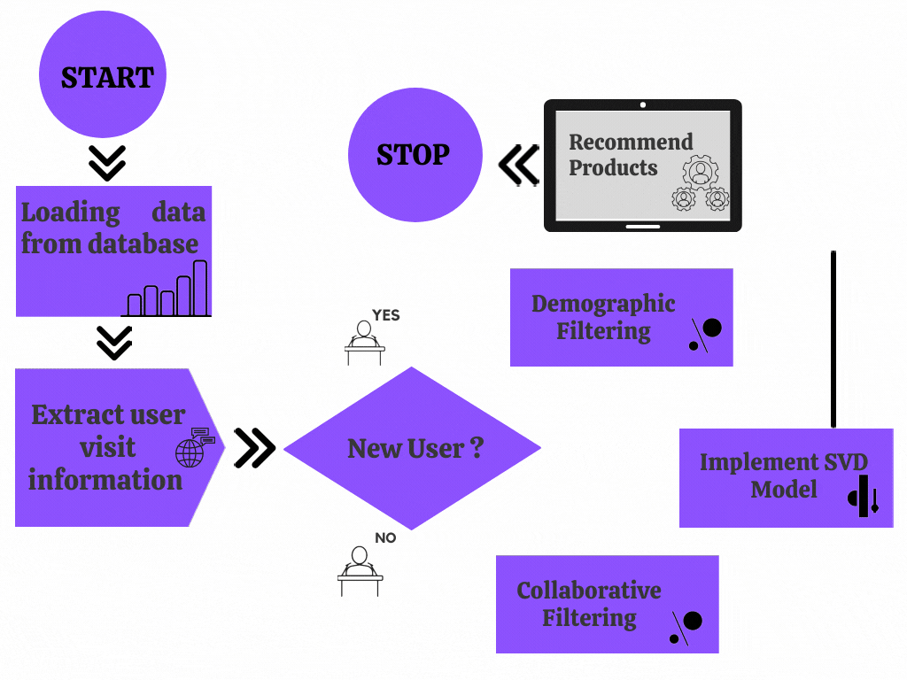
Machine Learning Model Training:

Slide 12
DEMONSTRATION

Slide 13

Click this mock up video for the preview of our website:

Slide 14
Future possible enhancements
Android/iOS Application:
We plan to extend this idea to a mobile application for user convenience and better accessibility.
Chat BOT:
We plan to design a chat bot to improve and facilitate better user-support and provide instant help.

Slide 15
THANK YOU!

